Slide 2
Outline

Slide 4
Micronutrients for ADHD in Youth Study (MADDY)

Slide 6
Study Design (N=126)

Slide 7
Study Guidelines

Slide 8
International Society for Nutritional Psychiatry Research (ISNPR)

Slide 9
Delphi Process

Slide 10
Clinical Trial Guidelines

Slide 11
Recommendations: Study Team

Slide 12
Recommendations: Trial Design

Slide 13
Recommendations: Participants

Slide 14
Recommendations: Interventions

Slide 15
Recommendations: Comparator

Slide 16
Recommendations: Outcomes

Slide 17
Recommendations: Reporting Outcomes

Slide 18
Recommendations: Future Research

Slide 19
Summary

Slide 20
Blood Sampling

Slide 21
Blood sample collection

Slide 23
Pain & anxiety relief during specimen collection

Slide 25
Baseline association of Suicidality with pro- and anti-inflammatory immune factors in children with ADHD

Slide 26
Baseline association of Suicidality with pro- and anti-inflammatory immune factors in children with ADHD

Slide 29
Stool Collection

Slide 30
Sample Collection

Slide 31
Procedure

Slide 32
Microbiota data generation and processing

Slide 33
Microbiome Results

Slide 34
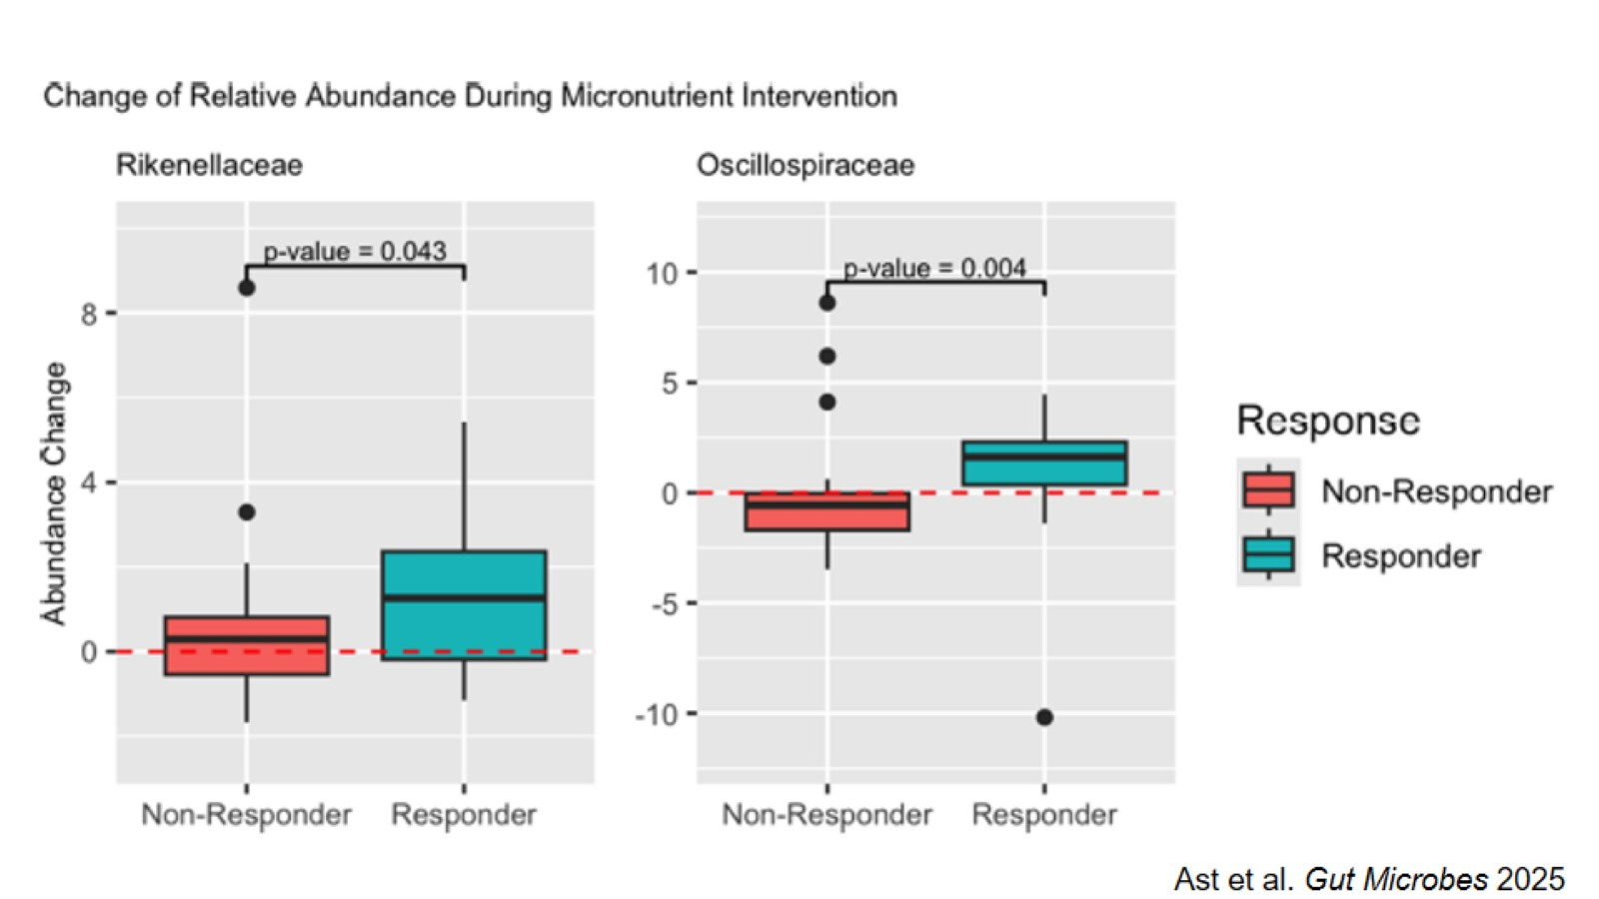

Slide 35
Metabolite identification and analysis

Slide 36
Metabolite Analysis

Slide 37
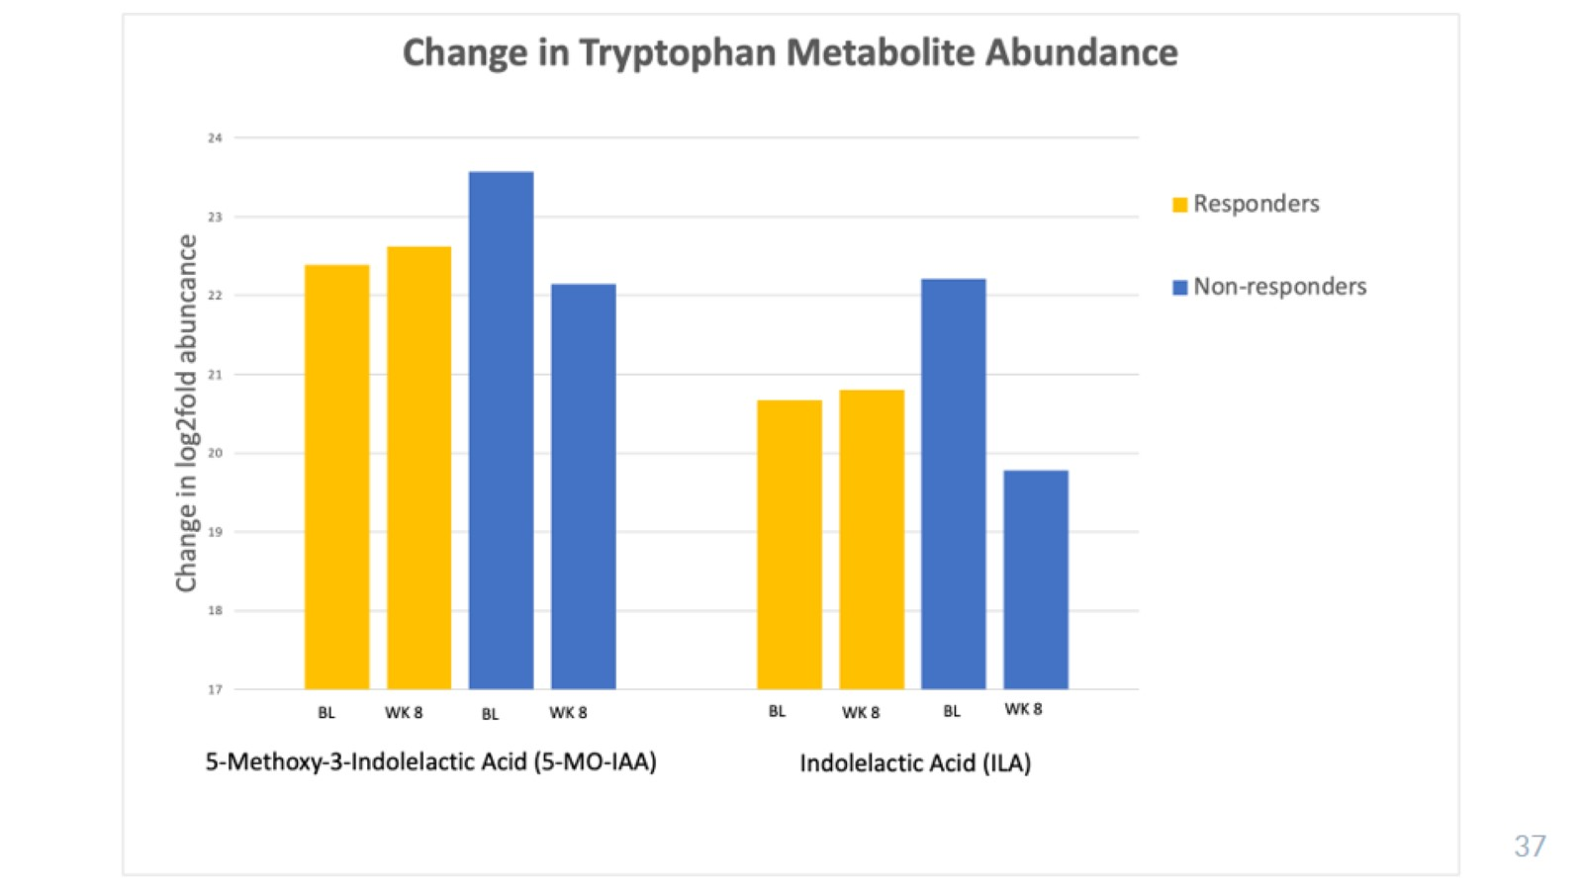

Slide 38
Urine Collection

Slide 40
Liquid Urine

Slide 41
Dried Urine

Slide 42
Dried Biosampling

Slide 43
Stability of Analytes

Slide 44
What is best for researchers?

Slide 45
Glyphosate - MADDY Study

Slide 46
Glyphosate

Slide 47
Results

Slide 49
Acknowledging our funders

Slide 50
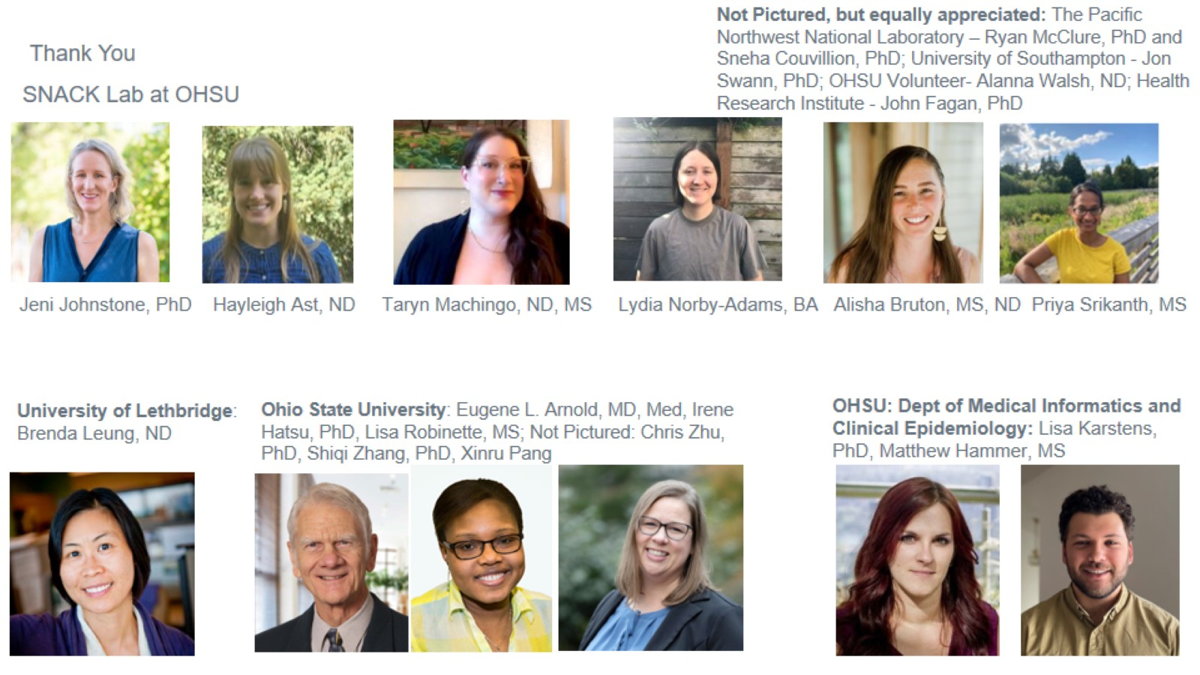
Thank You

Slide 51
Discussion

